Slide 1
Joined Up Landscapes
MACC Hub All team Meeting
20th January 2025
Dr Christian Reynolds (Christian.Reynolds@city.ac.uk)
Dr Christopher Yap (Christopher.yap@city.ac.uk)

Slide 2
The land use challenge
Food production
Environmental restoration, BNG
Carbon sequestration
Energy regeneration
Flood risk management
Rural livelihoods
Construction materials
Housing and infrastructure
Recreation, access, and wellbeing
Nature-Based Solutions… “actions to protect, sustainably manage and restore natural and modified ecosystems in ways that address societal challenges effectively and adaptively, to provide human well-being and biodiversity benefits.” (ICUN, 2020)

Slide 3
How can we enhance the medium-long term contribution of NBS?
How can we effectively manage, govern, and scale NBS in the medium-long term?
How can we effectively integrate NBS within multifunctional landscapes?
How can we optimize the impacts of NBS under different climate scenarios?
(How can we create an interdisciplinary evidence base on NBS)

Slide 4
Joined up Landscapes
WP1: Global Review of Nature-Based Solutions
WP2: Participatory Evaluation and Policy Integration
WP3: Test and Trial Approach
WP4: Data-Led Evaluation and System Dynamics Modelling
WP5: Capacity Building and Knowledge Exchange
M1(31Dec2024)...........................M12...............................................M20............M30(Jun2027)

Slide 5
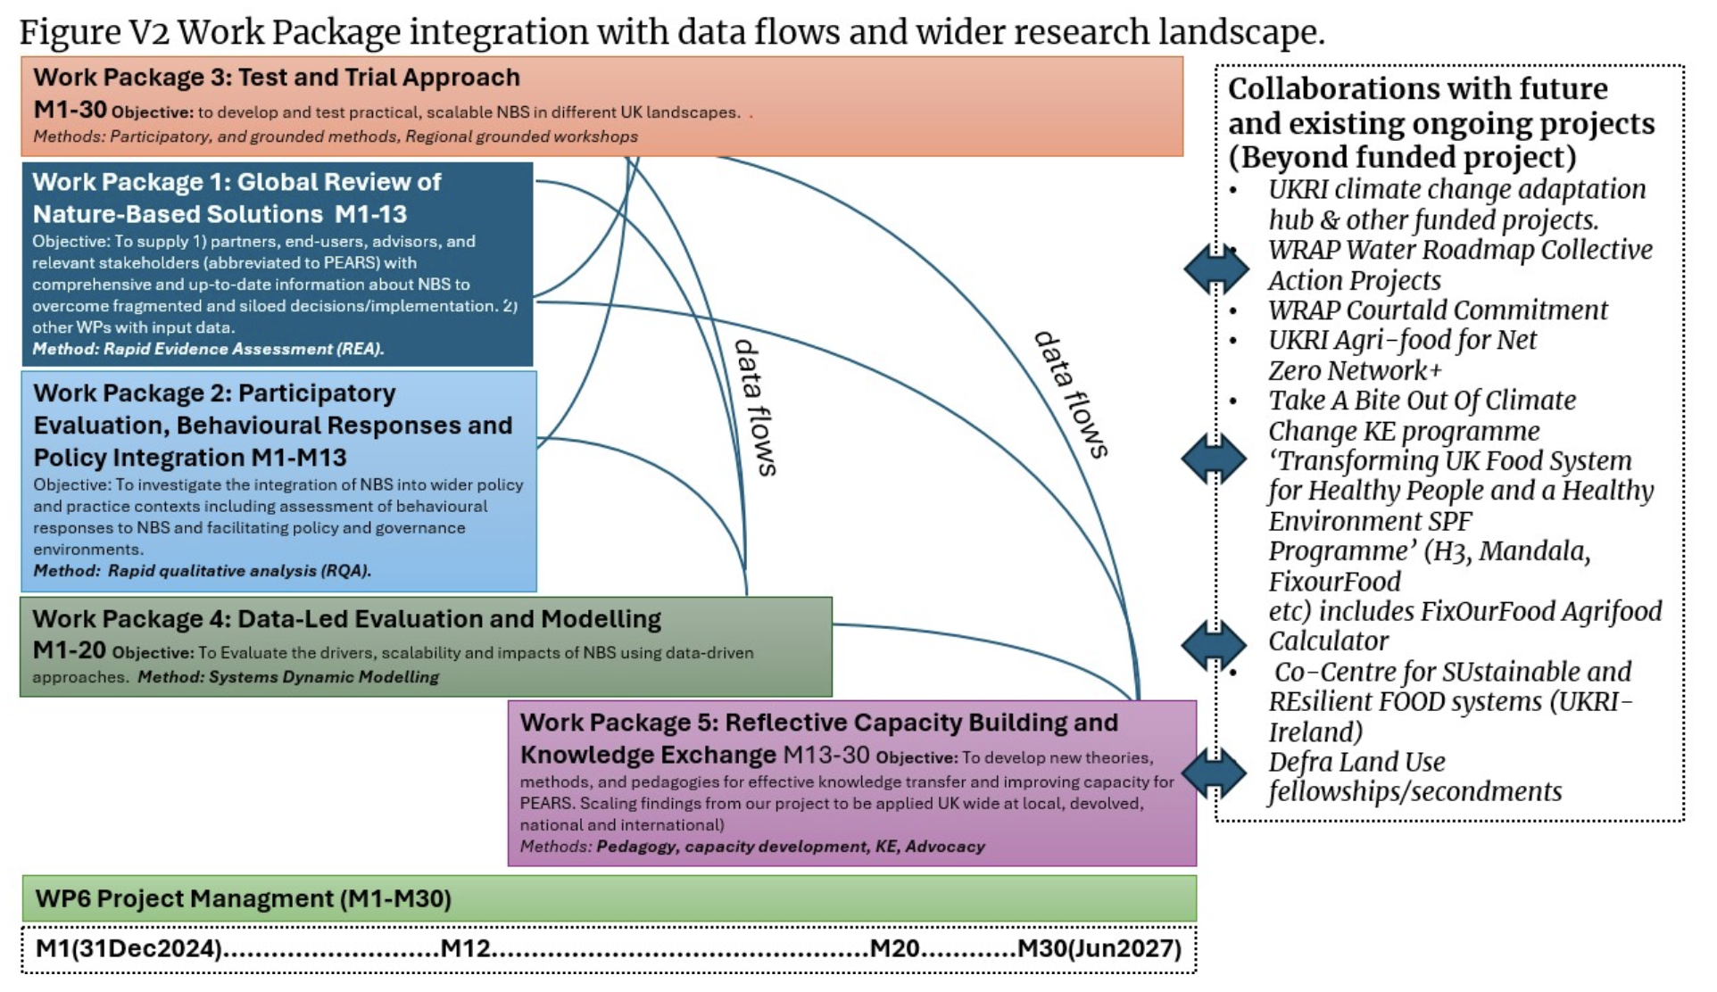

Slide 6
Joined up Landscapes
WP6: Project Management
Co-Leads:
Dr Christian Reynolds
Dr Christopher Yap
Project manager: Dr Elaine Hudson
WP1: Global Review
(M1-13)
Co-Leads:
Dr Christian Reynolds
Dr Kelly Parsons
Dr Andrew Bladon
Dr Ferne Edwards
WP2: Qualitative Research and Participatory Evaluation
(M1-13)
Lead: Prof Christina Vogel
Research Fellow
Research Assistant
WP3: Test and Trial
(M1-30)
Lead: Dr Christopher Yap
Research Fellow
Dr Steven Willey
WRAP
South East Rivers Trust
North Essex Farm Cluster
Wye and Usk Foundation
WP4: Modelling
(M1-20)
​
Lead: Dr Katie Manning
Dr Oliver Perkins
Dr Juan Pablo Cordero Garayar
Met Office
WP5: Capacity Building and Knowledge Exchange (M13-30)
Lead: Dr Christian Reynolds
Dr Rebecca Wells
Prof Sarah Bridle
Dr Juan Pablo Cordero
Dr Garayar Ximena Schmidt
Dr Steven Willey
Alex Hardie

Slide 7
End of presentation
School of Health & Psychological Sciences
City, University of London
Northampton Square
London
EC1V 0HB
United Kingdom
T: +44 (0)20 7040 5060
E: department@city.ac.uk
www.city.ac.uk/department

